Slide 1
Introduction to Machine Learning Random Forests Methods club – 24/02/20
Mahdad Jafarzadeh Esfahani

Slide 2
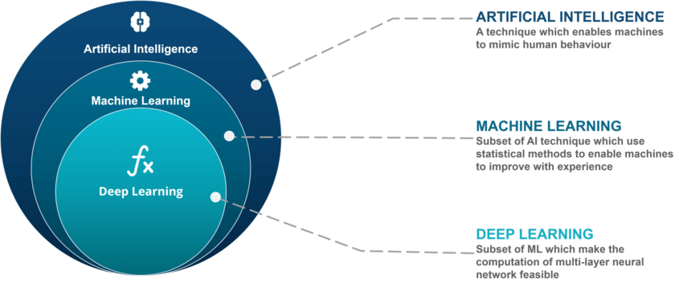
Background
Notes:
Artificial intelligence Rule based expert systems : Algorithms of this class consist of rules made by experts which are executed by the machine.
If amplitude>40, stage = SWS". transparent classification.
Disadvantage is that the chosen rules might be suboptimal and are usually very simple.

Slide 3
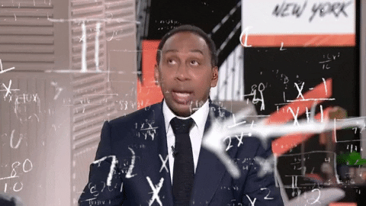
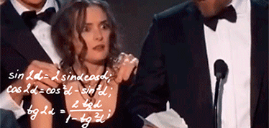
Simplification

Slide 4
Decision trees
Do you have a resting heart rate of > 100 bpm
If a person loves sleep research?
True False
True False
See a doctor!
No worries
Then the person is awesome!
The person is slightly less than awesome!
Notes:
In general DT asks a question and then classifies the results based on the answers.
This question can be a categorical one or numeric

Slide 5
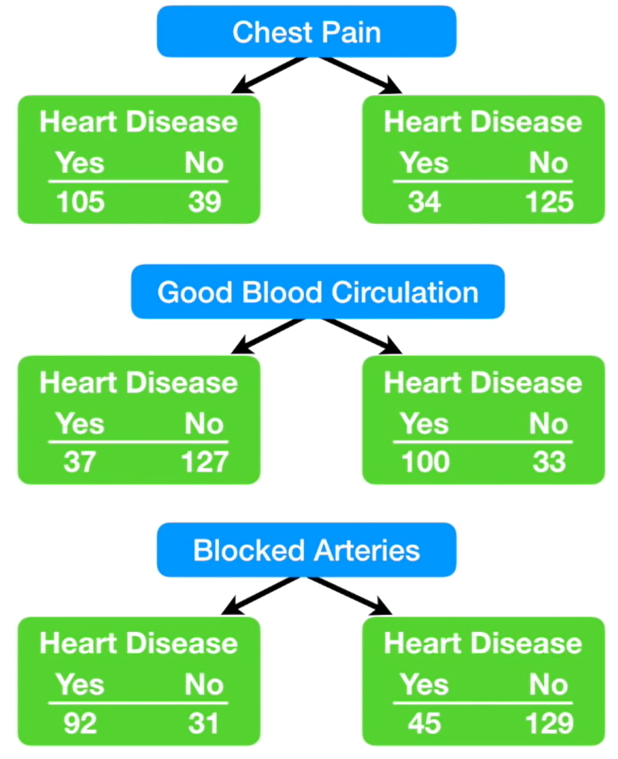
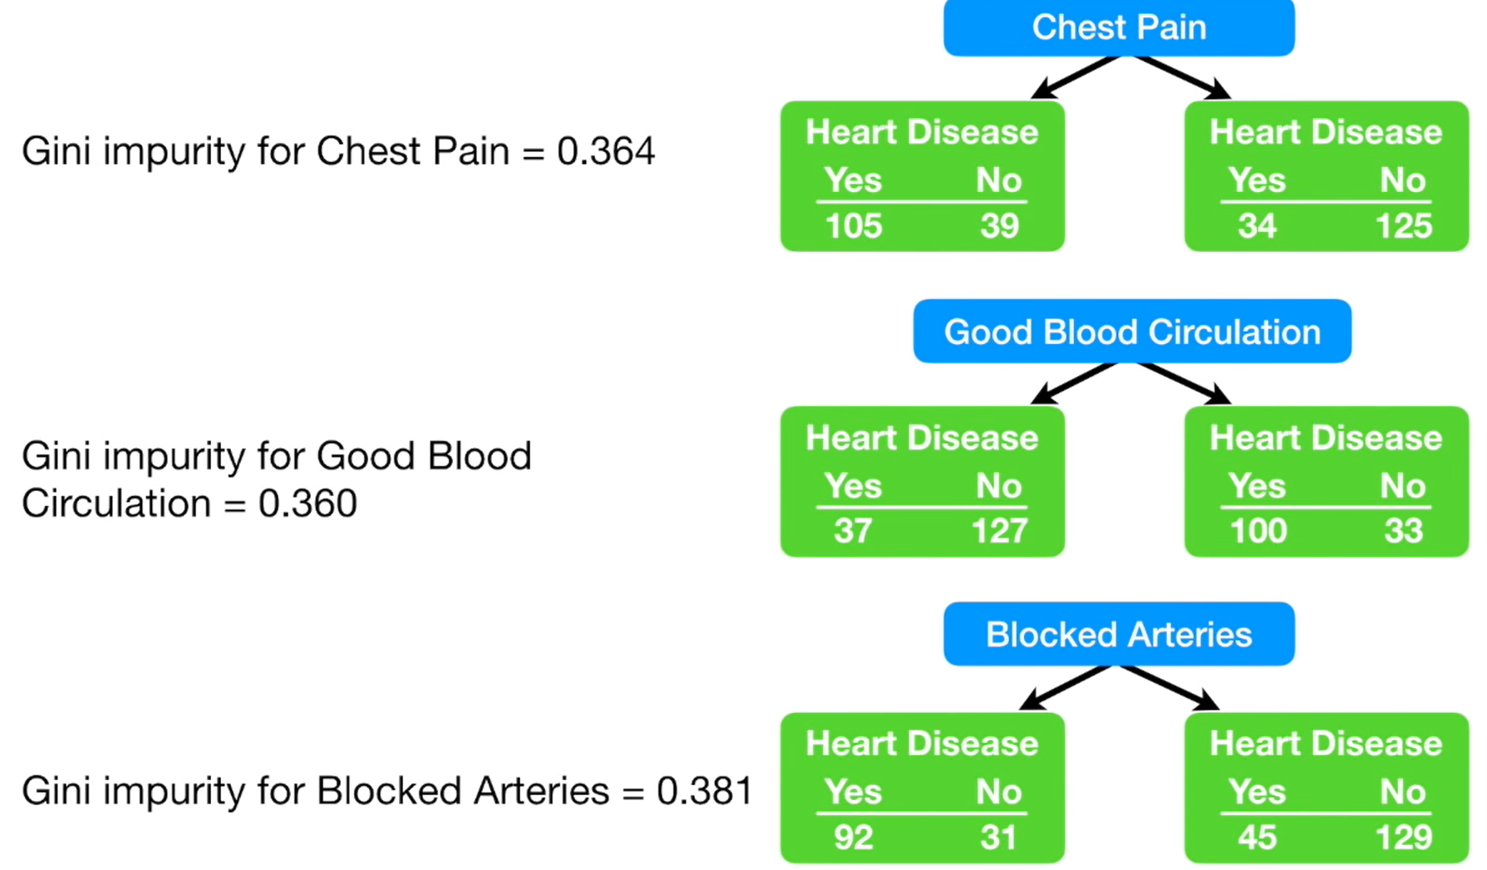
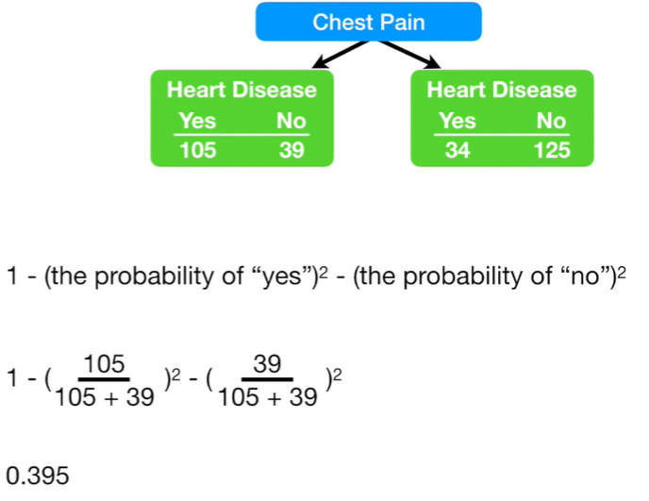
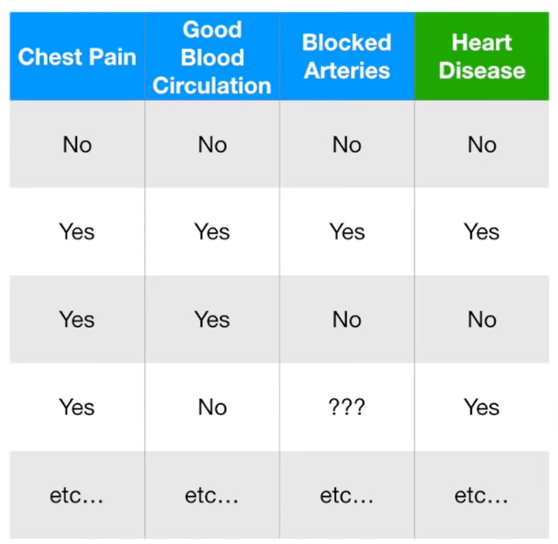
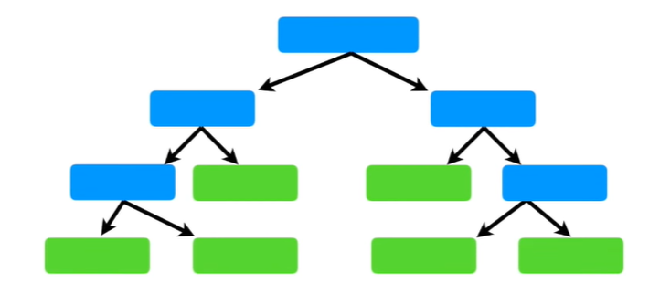
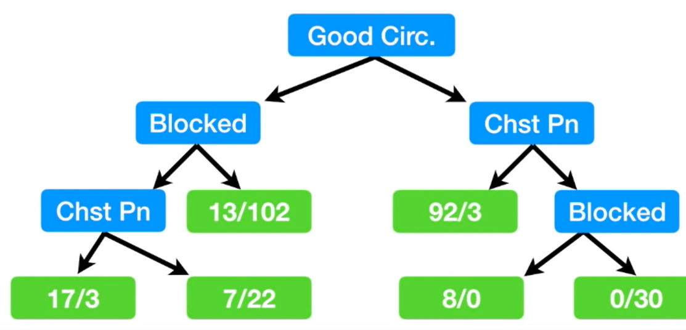
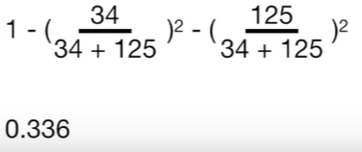
Decision tree
As there is no feature that 100% classifies outcome (Heart disease) we need to calculate impurity rates per feature vector.
Gini impurity is a measure to decide about the order of questions in the decision tree.
The order of nodes in decision tree is dependent on the impurity factor.
Once the feature for the current node is found, we continue the same procedure to find the proper for the next node.
Final findings of the current example:

Slide 6


Decision tree - Disadvantages
Overfitting
Calculation can go far more complex compared to other algorithms.
Inadequate for applying regression and predicting continuous values
Notes:
small change in the data can lead to a large change in the structure of the optimal decision tree.

Slide 7
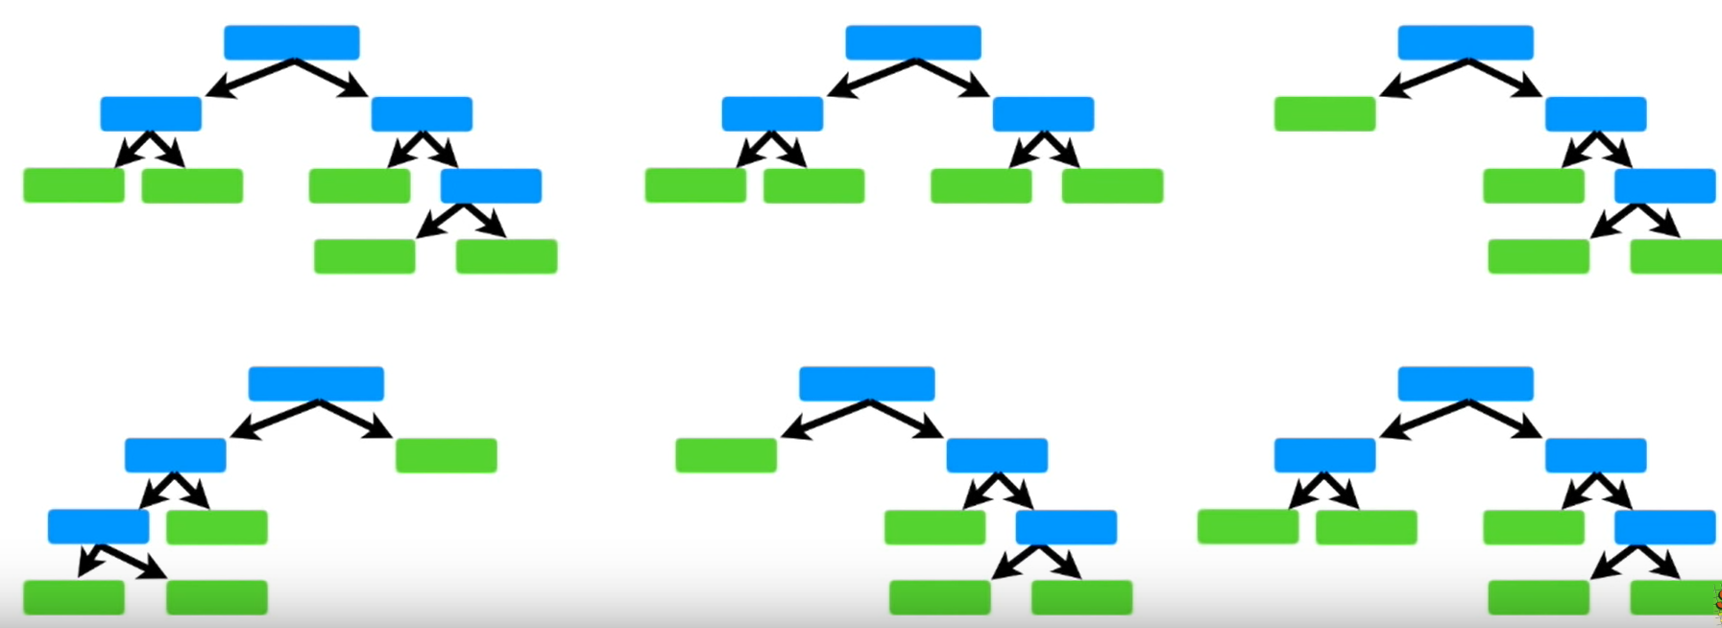
Random Forests
Combination of numerous decision trees.
Each tree picks a portion of data and feature set.
How does that work?
Creating a bootstrap dataset (randomly select from the dataset).
Randomly select some of the available features.
Create a tree!

Slide 8
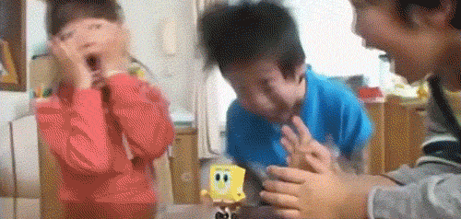
Ready for hands-on?
- Sample dataset and template code can be found on OSF.

